Slide 1
SQL QUERIES FOR FILM DATA
PROJECT

Slide 2
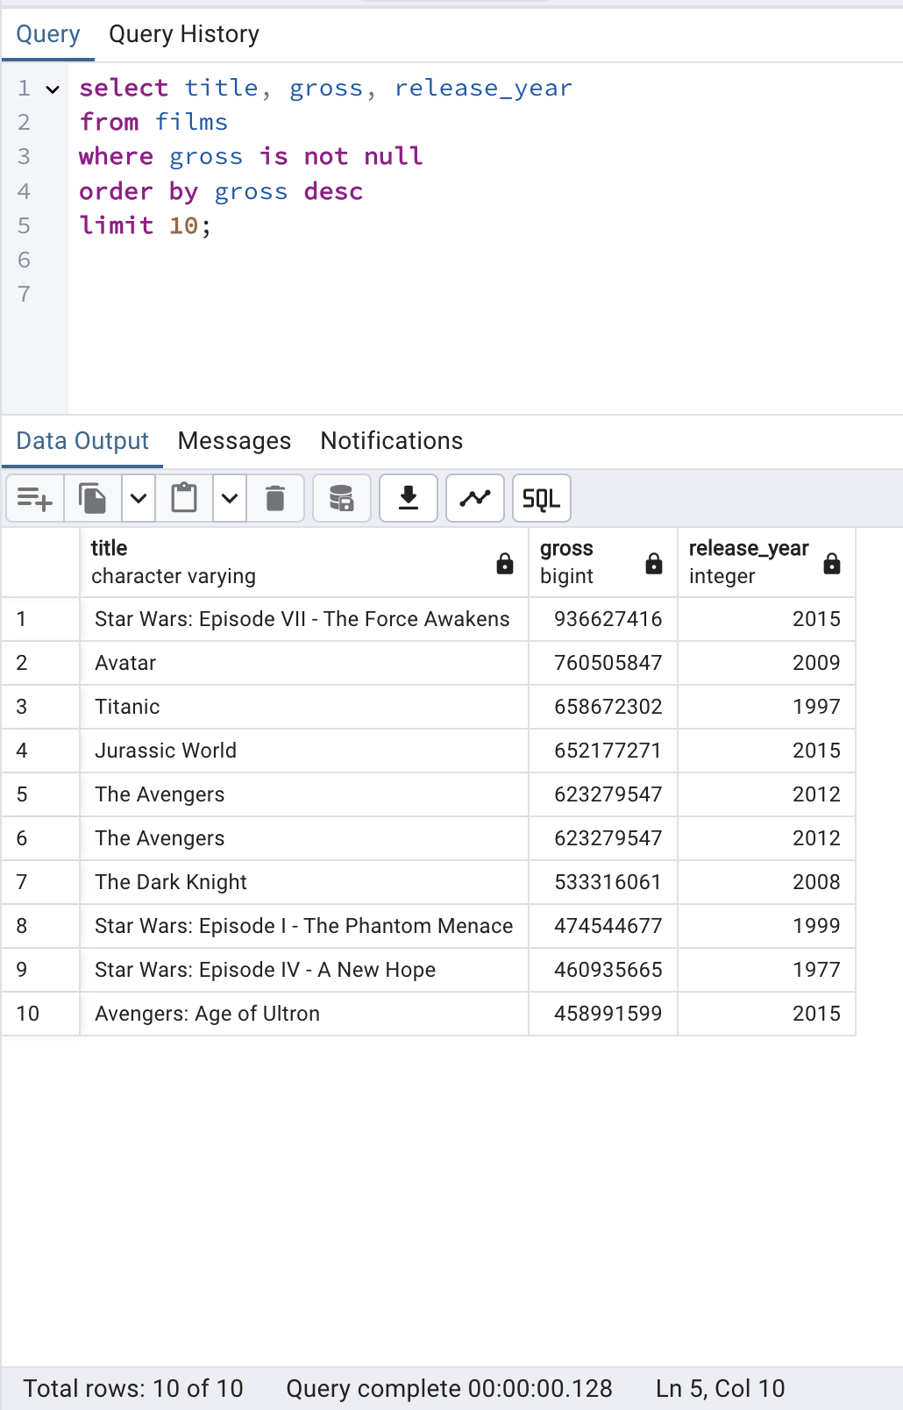

What are the top 10 highest-grossing films in the database, and when were they released?

Slide 3
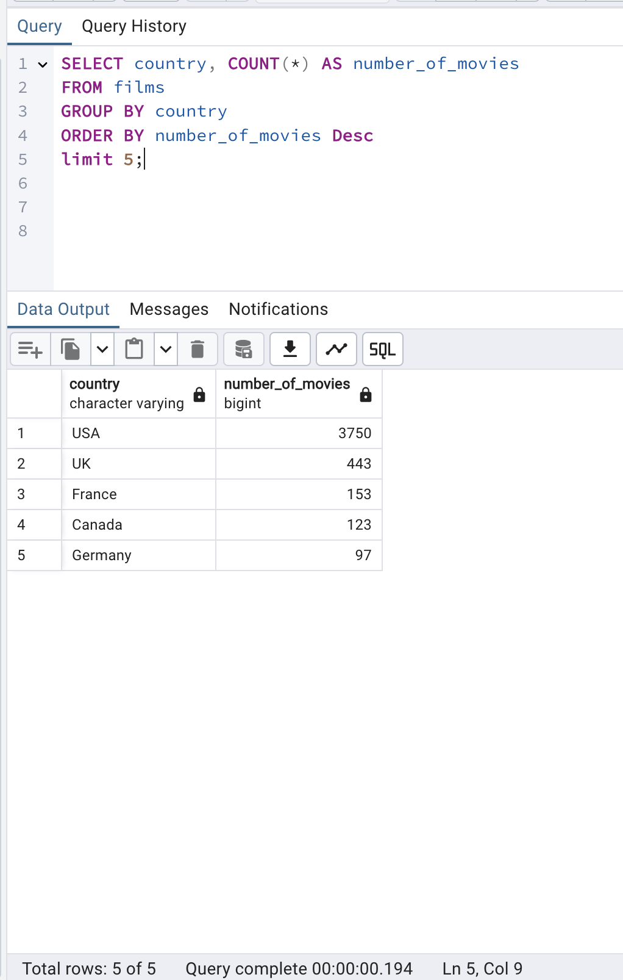
How many films in the database were released in each country, and what are the top five countries?

Slide 4
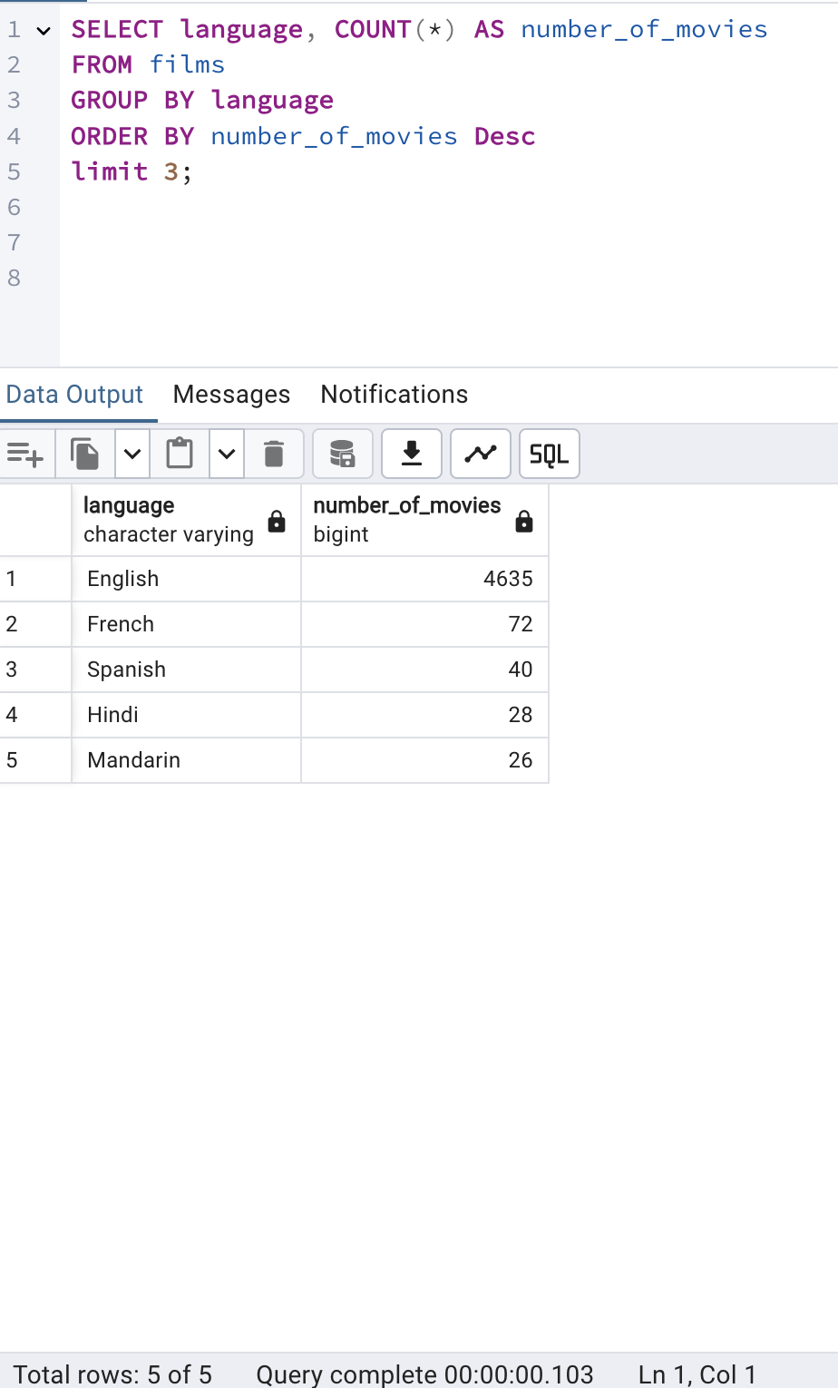
How many films are available in each language, and what are the top three languages represented?

Slide 5
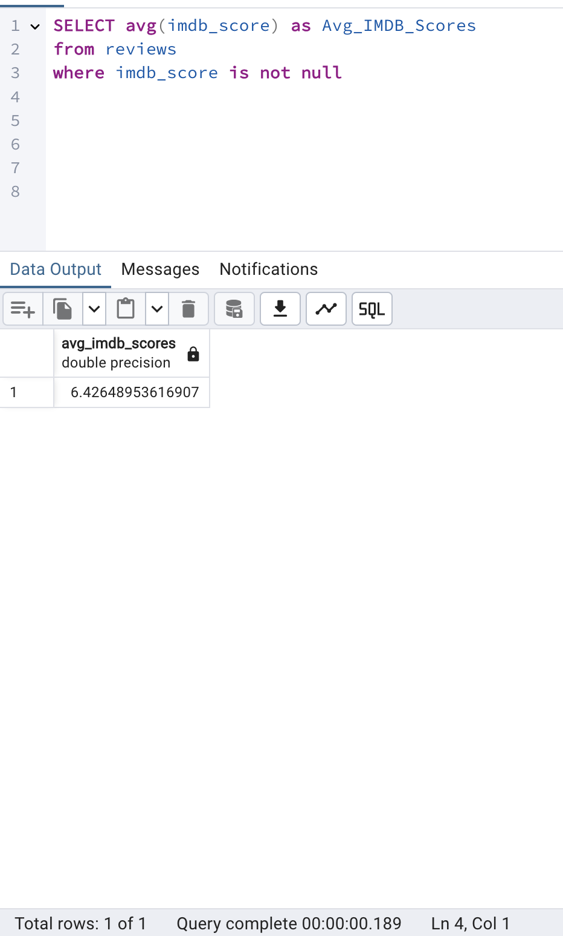
What is the average IMDb score for films in the database?

Slide 6
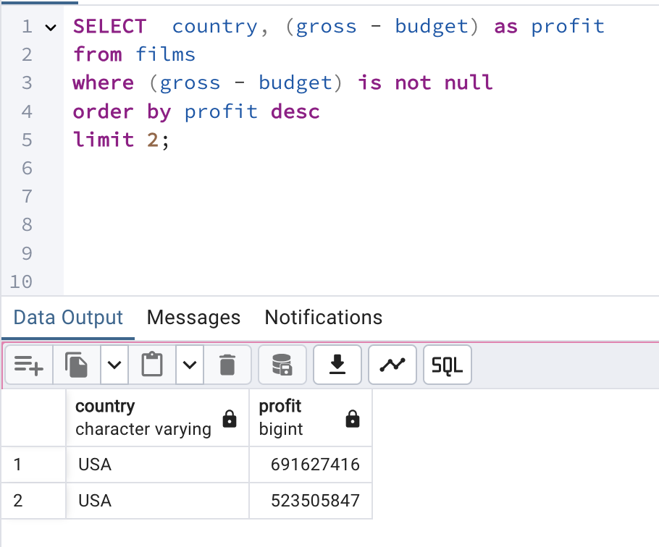
Which country has made the highest profit from movies?

Slide 7
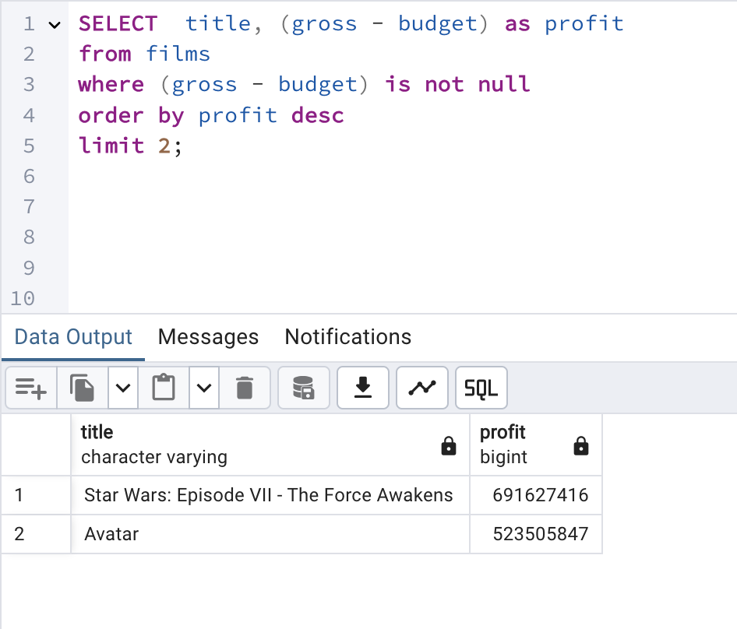
Which movie made the highest profit in the 21st century?

Slide 8
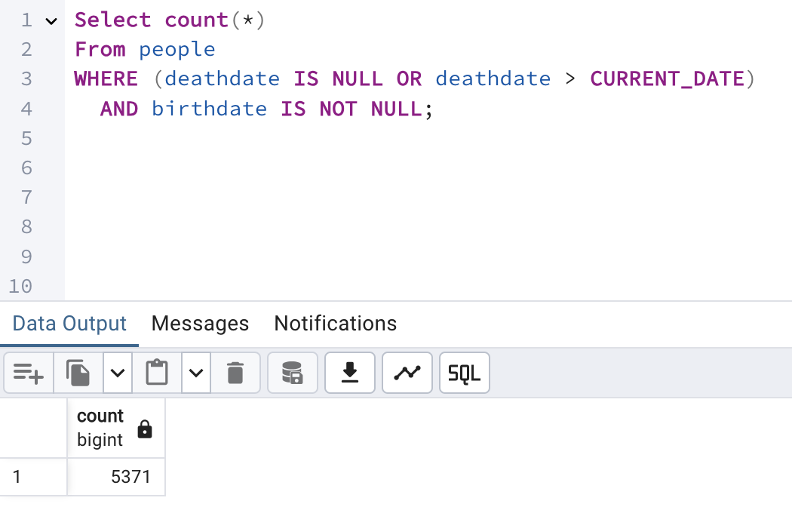
How many people in the database are still alive (based on birthdate and death date)?

Slide 9
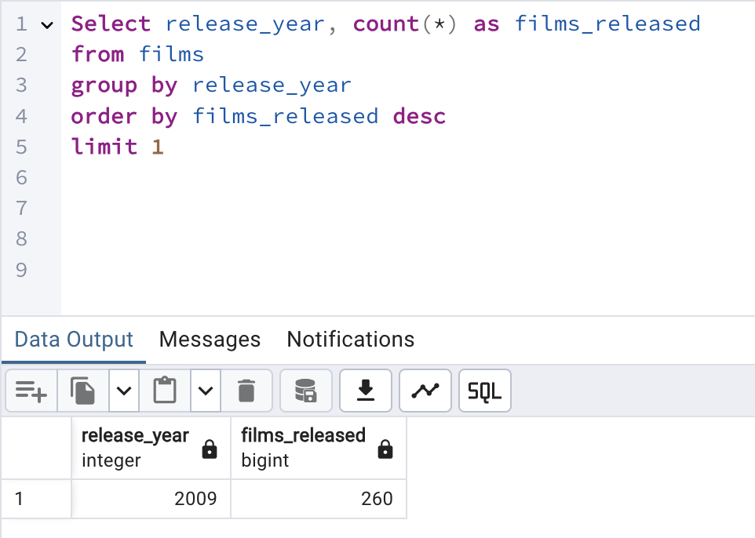
Which year has the highest number of movie releases?

Slide 10
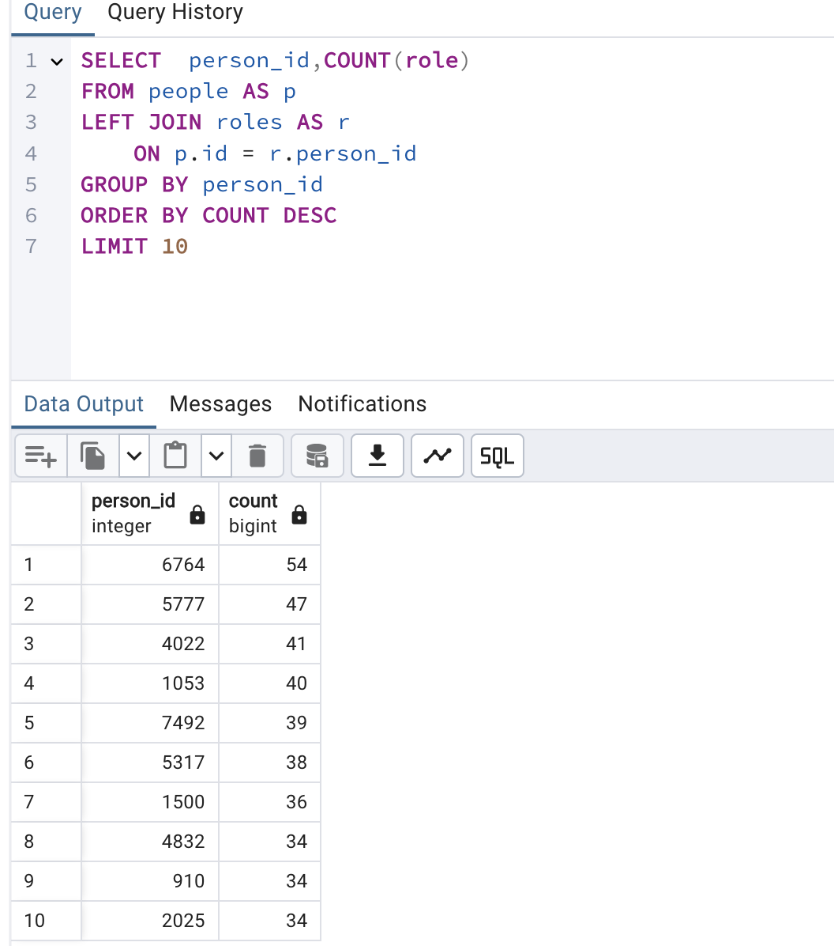
Determine the top 10 people with the most roles in the database.

Slide 11
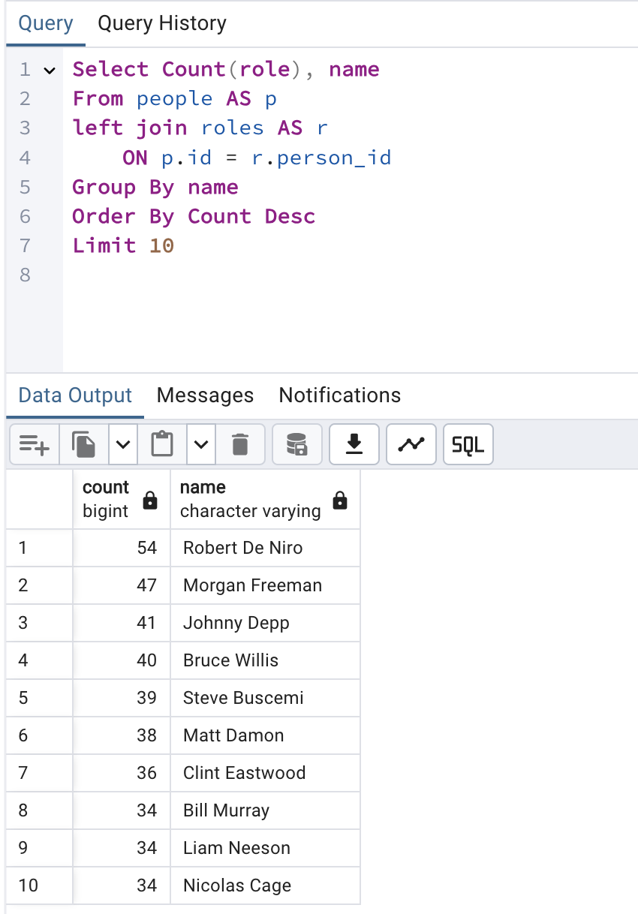
Who are the top 10 actors or directors with the most roles in the database?

Slide 12
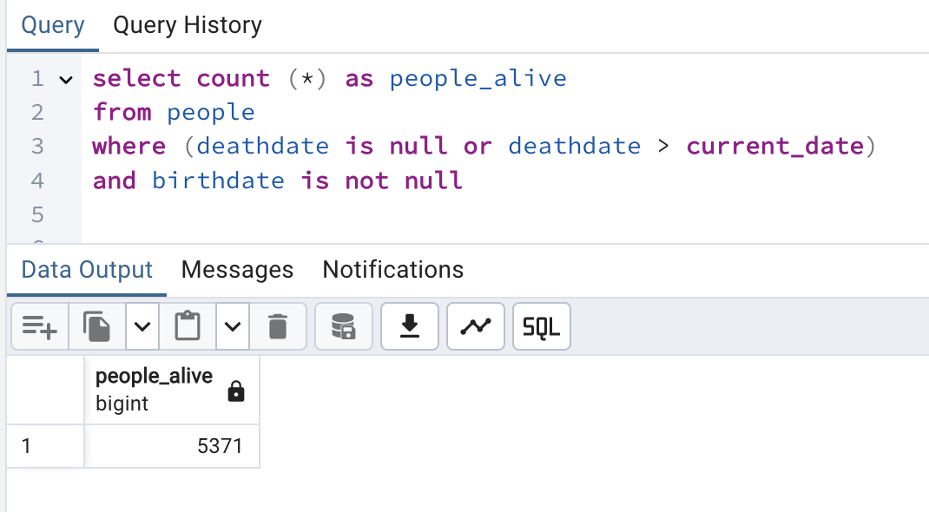
Identify how many people in the database are still alive

Slide 13
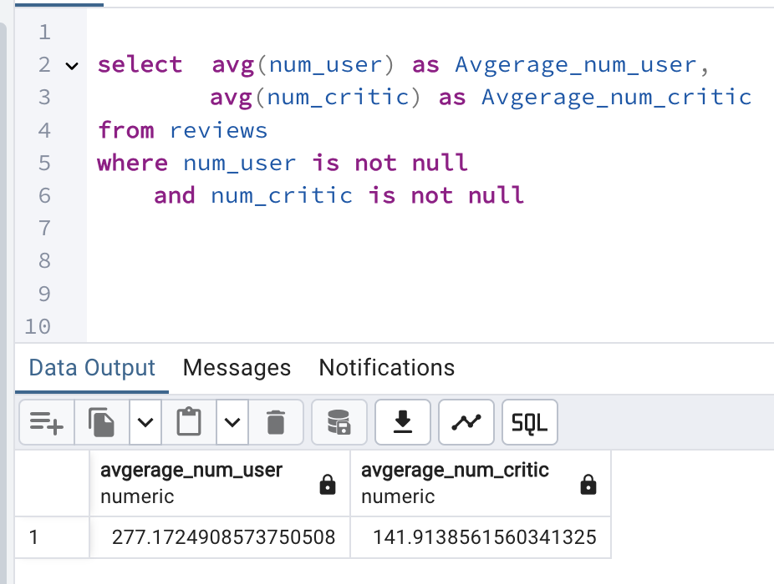
Calculate the average number of user and critic reviews for films.

Slide 14
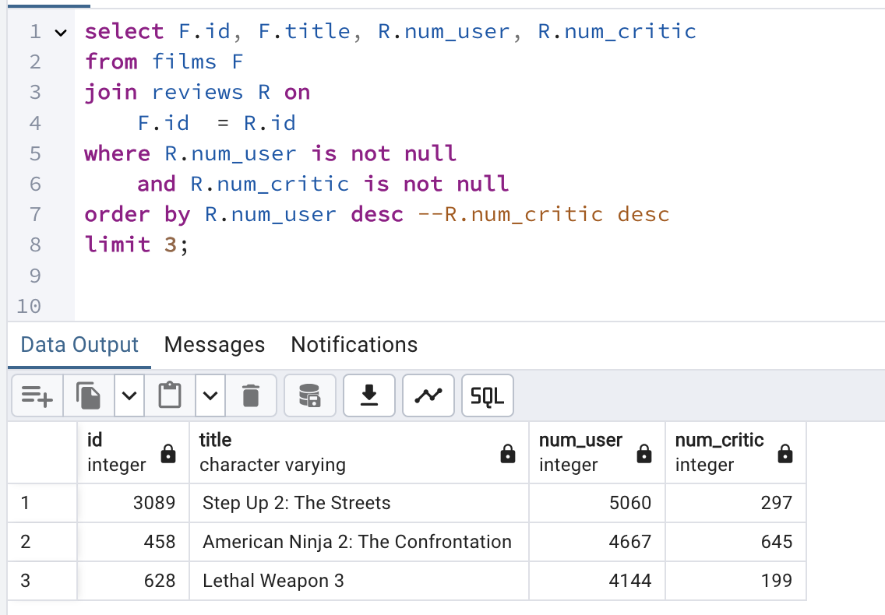
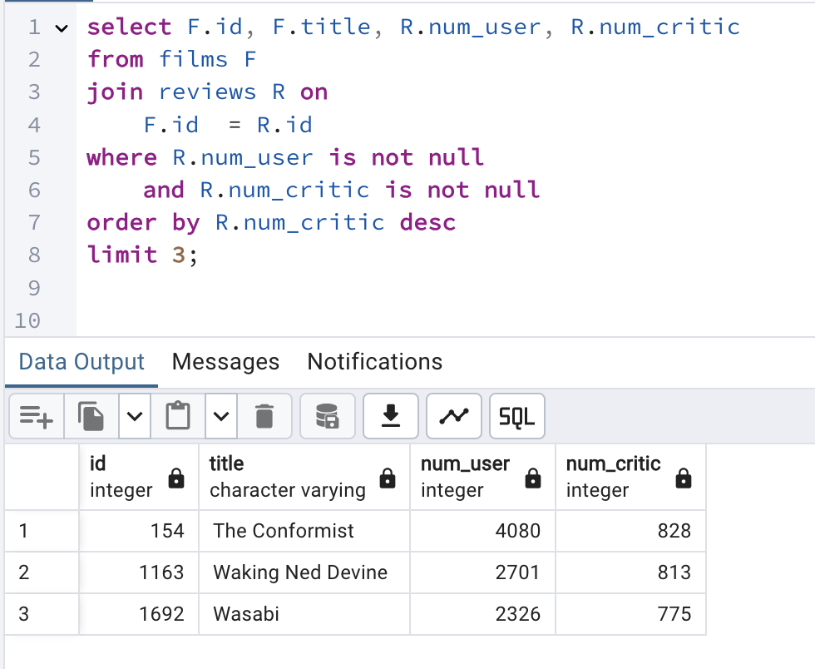
Identify films with the highest number of user and critic reviews.

Slide 15
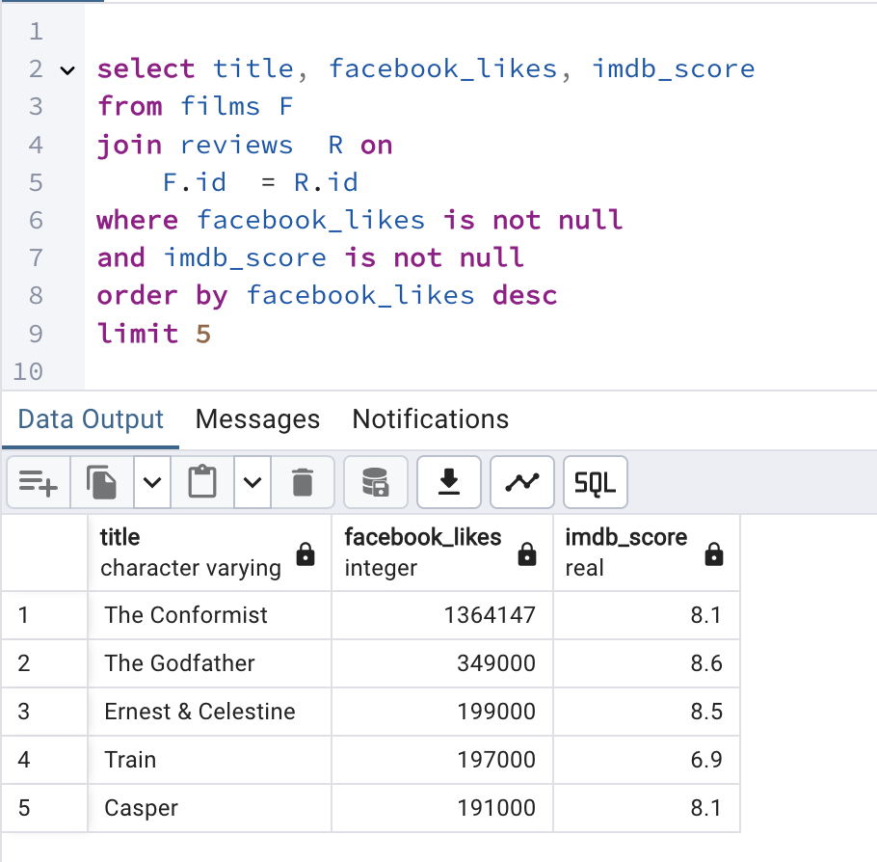
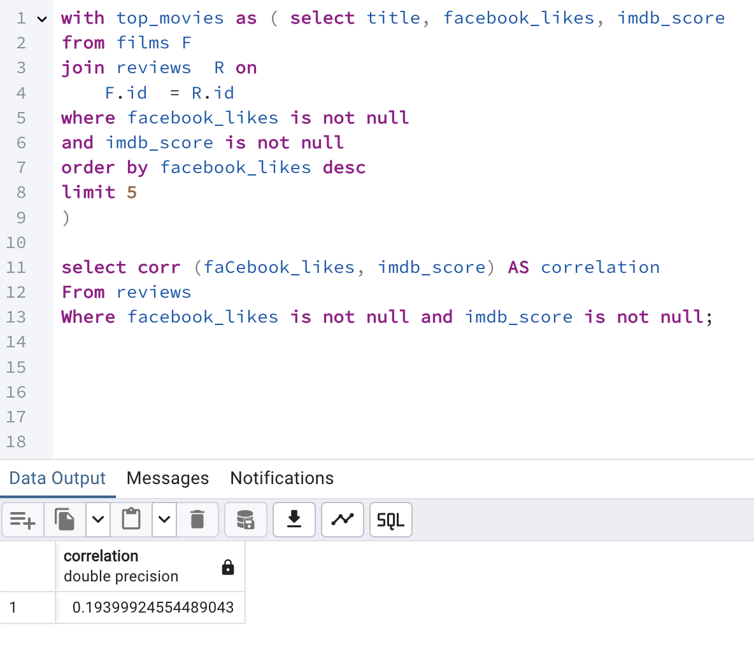
Which films have the most Facebook likes, and is there a correlation with their IMDb scores?

Slide 16
Thanks for Reading
Notes:
In Slide Show mode, select the arrows to visit links.

